Slide 1
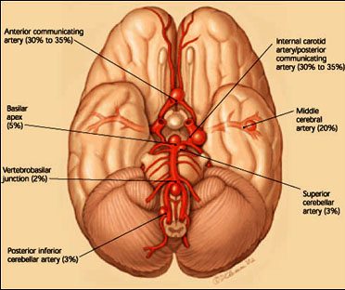
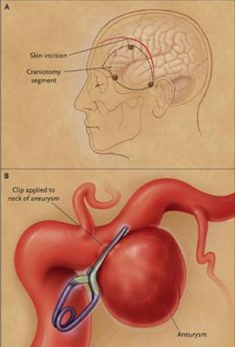
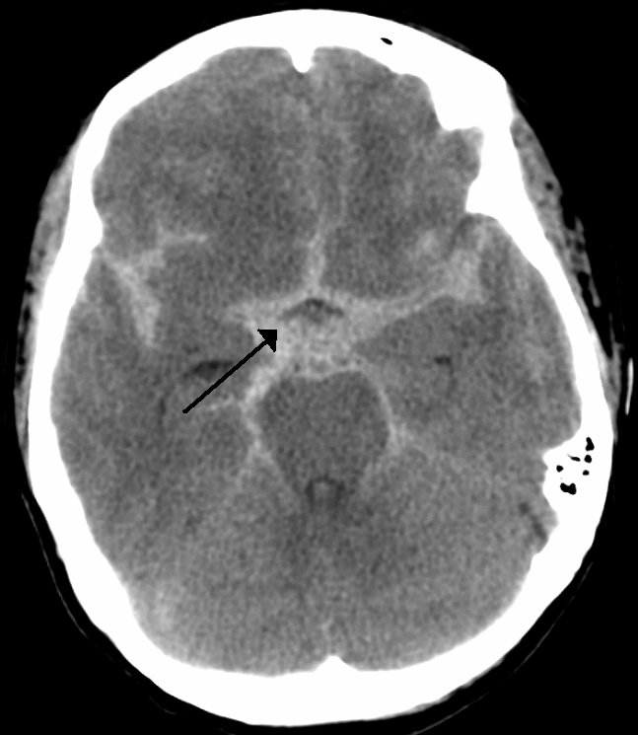
Interesting Case
Dx: Unruptured Anterior communicating artery Aneurysm
Op : Craniotomy for clipping aneurysm
ร.อ.ชาติชาย/อ.นวลวรรณ

Slide 2
Case
Case ผู้ป่วยหญิง 38 ปี
Chief complaint : นัดมาผ่าตัด
Present illness
6 เดือน PTA มีอาการแขนขาอ่อนแรงด้านซ้าย หน้าเบี้ยวด้านซ้าย -> Dx : Rt.Putaminal hemorrhage -> Conservative Rx
W/U ; MRI/MRA -> small saccular aneurysm at A-com size 0.15 cm
ปัจจุบันมีอาการแขนขาอ่อนแรงด้านซ้ายเล็กน้อย ไม่มีหน้าเบี้ยว

Slide 3
Past history
Underlying disease
HT
Losartan (50) 1x1 opc
Amlodipine (10) 1x1 opc

Slide 4
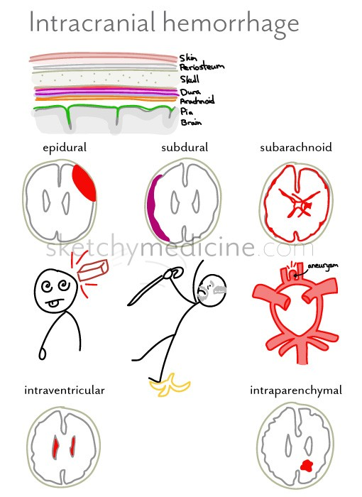
R 1 ซักประวัติเพิ่มเติม

Slide 5
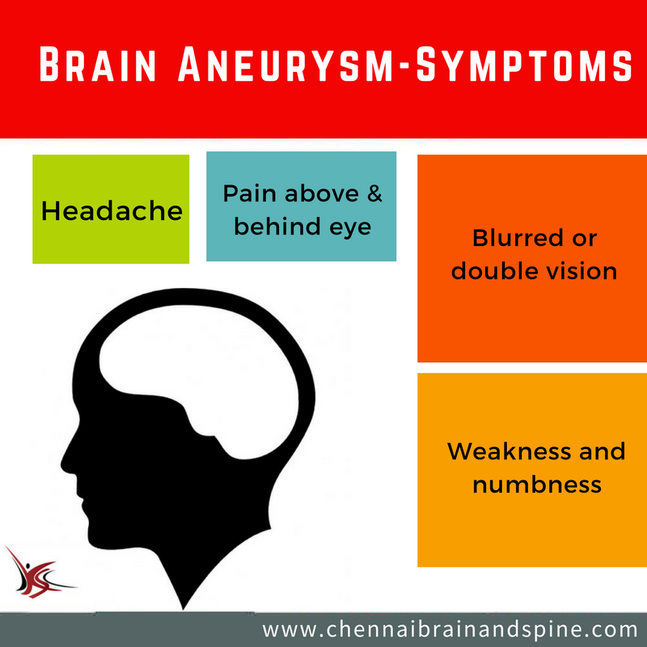
Hx เพิ่มเติม
ไม่มีปวดศีรษะ
ไม่มีอาเจียน
ไม่มีชัก
ไม่มีตาพร่ามัว
Symptoms

Slide 6
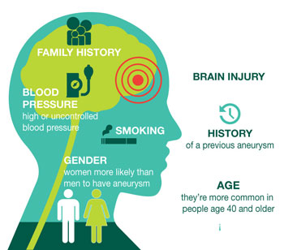
Hx เพิ่มเติม
No Hx Familial aneurysm
NO Hx Genetic disease
Ehlers-Danlos syndrome
ADPKD
NO Hx smoking
No Hx alcohol drinking
No Hx drug use ; cocaine
Risk Factors
Guidelines for the management of aneurysmal subarachnoid hemorrhage: a guideline for healthcare professionals from the American Heart Association/American Stroke Association. Stroke. 2012;43:
Notes:
incidental aneurysms in first-degree relatives of patients with an aneurysm was 9 percent
family history of aneurysm or subarachnoid hemorrhage confers a 3.6 times greater risk
least 1 first-degree family member with an intracranial aneurysm, and especially if >2 firstdegree relatives are affected

Slide 7
Hx เพิ่มเติม
No Hx drug/food allergy
NO Hx previous Sx
FC I

Slide 8
R 1 Physical examination

Slide 9
Physical Examination
Vital signs
BP 113/71mmHg PR 94 BPM
BT 36.3°C RR 18 breaths /min
BW 65 kg, Height 170 cm (BMI 22.49 kg/m²)
GA : A Thai female, good consciousness, well co-operated, not pale, no jaundice

Slide 10
Physical Examination
HEENT : not pale, no jaundice,
Lung : clear, equal breath sound both lungs
Heart: pulse full & regular ,no heaving, no thrill, normal S₁&S₂, no murmurs
Abdomen : soft, not tender, liver & spleen can not palpable
Extremities : no deformity, no pitting edema

Slide 11
Physical Examination
Neurological examination :
E₄M₆V₅
No facial palsy
Full EOM, Pupil 2 mm RTLBE
No papilledema
Sensory intact
Motor grade V/IV+
DTR

Slide 12
Physical Examination
Airway examination :
Limit neck of motion : No
Thyromental distance > 6 cm
Mouth opening > 3 cm
Upper lip bite test : grade 1
Prominent incisor : No
Mallampati grade : grade 2

Slide 13
R 1 Investigation

Slide 14
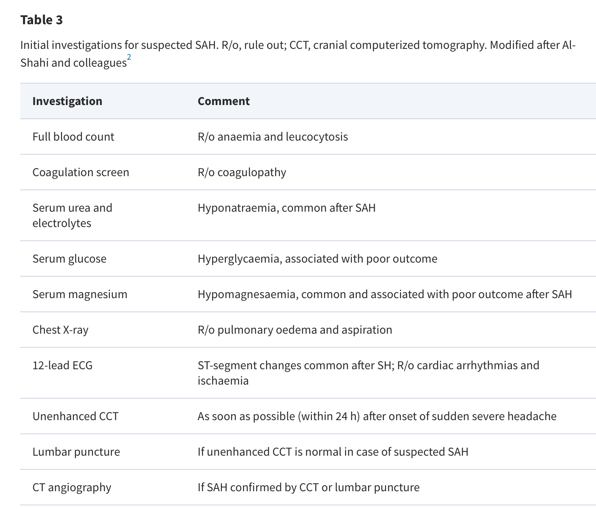

Slide 15
Investigation
CBC: Hb 12.8 gm/dl, Hct 41%, Platelet 289,000/mm³
Coagulogram: PT 12.5/0.95 ,aPTT 22.2/0.84 ,TT 12/1.21
Electrolytes: Na 140, K 4.04, Cl 103.2, CO₂ 21.8
BS: 110 mg/dL
BUN: 9.2 mg/dL Cr:0.62mg/dL eGFR: 114
CXR : no infiltration, no cardiomegaly
EKG : NSR rate 76/min ,no ST-T change

Slide 16
Investigation
CT brain NC 12/4/60
2.2 x 2.6 x 2.3 cm encephalomalacic change post ICH at Rt. putamen
MRI/MRA brain 20/4/60
Small saccular aneurysm at A-Com region size 0.15 cm
Cerebral angiography
Unruptured saccular aneurysm at anterior communicating artery size 0.2 x 0.4 cm

Slide 17
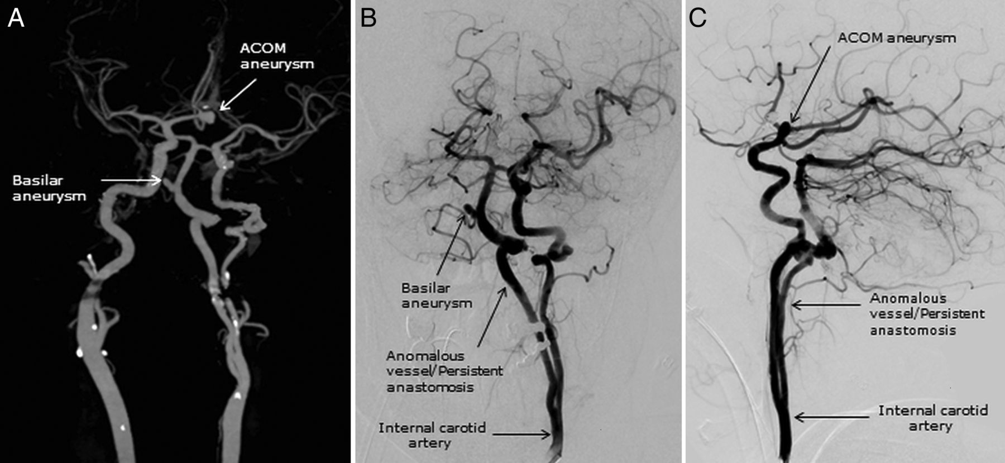
Investigation
Digital subtraction angiography (DSA)
Gold standard
Invasive procedure
Rustemi O, Alaraj A, Shakur SF, et al. Detection of unruptured intracranial aneurysms on noninvasive imaging. Is there still a role for digital subtraction angiography? Surgical Neurology International. 2015;6:175. doi:10.4103/2152-7806.170029.
Notes:
CTA ->greater than 4 mm with nearly 100 % sensitivity/pooled 97 % sensitivity rate for all aneurysm sizes/For aneurysms 3 mm sensitivity numbers 84
MRA -> imited spatial resolution offered by MRA decreases its accuracy in evaluating small aneurysms (< 3-5 mm)

Slide 18
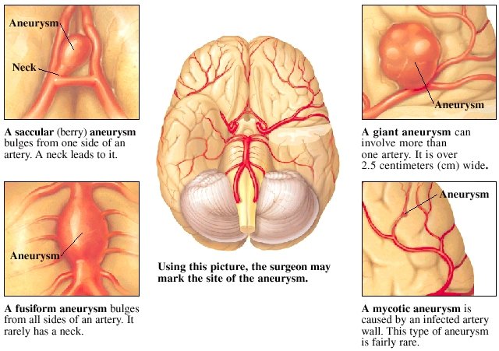
Cerebral aneurysm
Type of aneurysm
Review of Cerebral Aneurysm Formation, Growth, and Rupture.Nohra Chalouhi, Brian L. Hoh and David Hasan.Stroke. 2013;44:3613-3622, originally published November 25, 2013
Notes:
Review of Cerebral Aneurysm Formation, Growth, and Rupture.Nohra Chalouhi, Brian L. Hoh and David Hasan.Stroke. 2013;44:3613-3622, originally published November 25, 2013

Slide 19
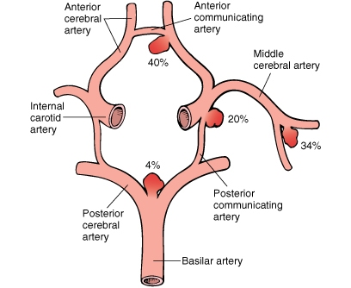
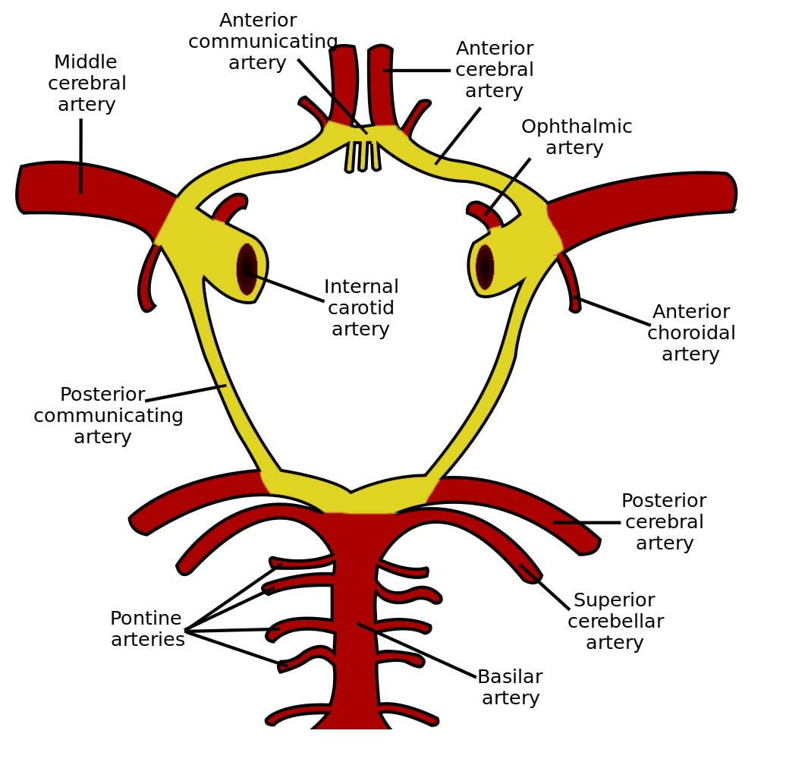
Cerebral aneurysm
Location of aneurysm
Review of Cerebral Aneurysm Formation, Growth, and Rupture.Nohra Chalouhi, Brian L. Hoh and David Hasan.Stroke. 2013;44:3613-3622, originally published November 25, 2013

Slide 20
R2 Problem list

Slide 21
Problem list
Female 38 yrs
Unruptured anterior communicating artery Aneurysm -> Craniotomy for clipping aneurysm
U/D HT, Hemorrhagic stroke

Slide 22
ASA classification
ASA III
HT, Hemorrhagic stroke

Slide 23
Cerebral aneurysm
Prevalence 3.2 %
Mean age 50 yrs
Gender 1:1 ratio
Female prepordance at age>50
20 to 30 % have multiple aneurysms
Aneurysmal SAH occurs 6 to 16 per 100,000 population
Vlak MH, Algra A, Brandenburg R, Rinkel GJ. Prevalence of unruptured intracranial aneurysms, with emphasis on sex, age, comorbidity, country, and time period: a systematic review and meta-analysis. Lancet Neurol. 2011 Jul;10(7):626-36. doi: 10.1016/S1474-4422(11)70109-0. Review. PubMed PMID: 21641282.

Slide 24
CASE
Unruptured cerebral aneurysm
Small saccular aneurysm at A-Com region size 0.15 cm

Slide 25
R2 Preoperative evaluation

Slide 26
Preoperative evaluation
Assessment of the patient’s neurologic condition and review intracranial pathology
Evaluation systemic complication and patient coexisting disease
Communication with the neurosurgeon
Optimization of the patient’s condition

Slide 27
Preoperative evaluation
Assessment
Neurologic condition
Grading SAH
Modified Hunt and Hess -> 0
World Federation of Neurological Surgeons’ Grades -> 1
Modified Fisher Grades -> 0

Slide 31
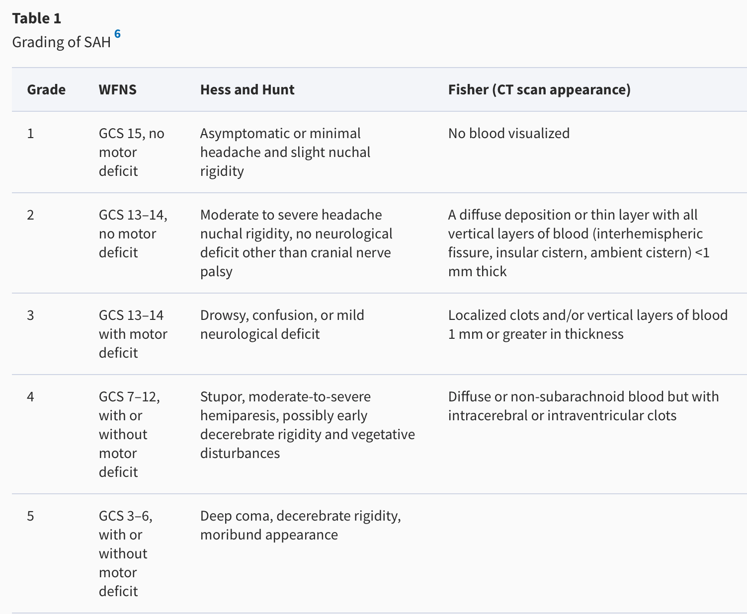

Slide 32
Preoperative evaluation
Modified Hunt and Hess -> 0
World Federation of Neurological Surgeons’ Grades -> 1
Modified Fisher Grades -> 0
Predict outcome
Risk of vasospasm
Increased ICP

Slide 34
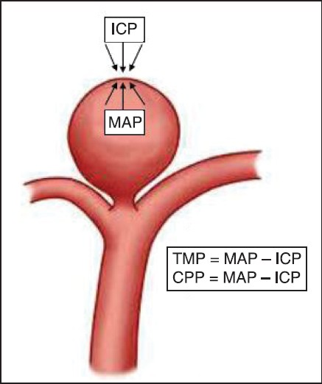
Grading
Low grade
High grade
H&H grade I-II
ICP normal
H&H grade III-IV
Increased ICP
High complication
Rebleeding
Vasospasm
Ischemia

Slide 35
Preoperative evaluation
Evaluation of other systemic condition
Systemic effect of SAH
Hypovolemia & Hyponatremia
Cardiac arrhythmia
MI
Neurogenic pulmonary edema
Seizure
Fever

Slide 36
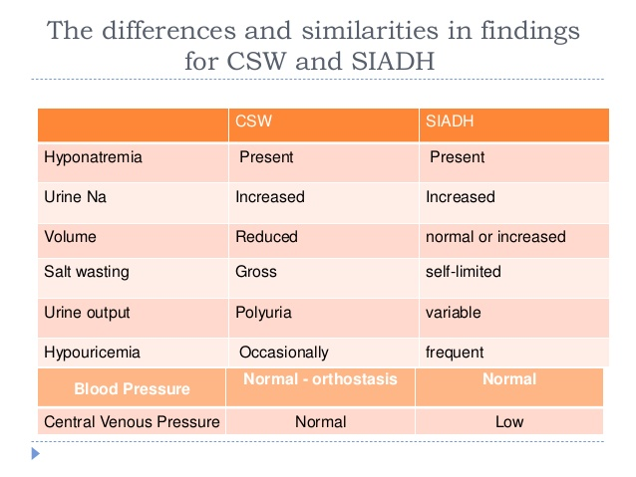
Hyponatremia

Slide 37
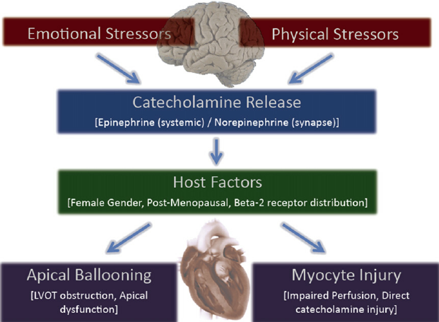
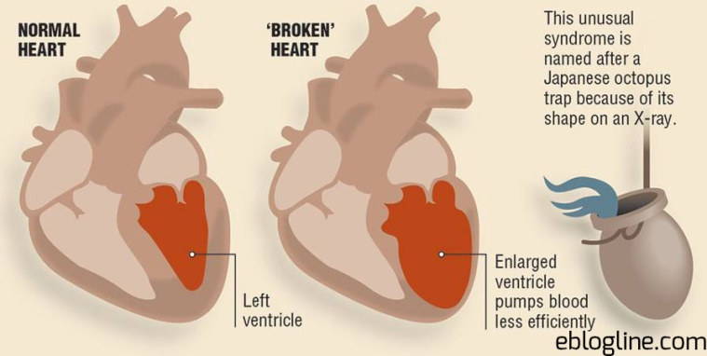
Cardiac abnormalities
Abnormal ECG
Arrhythmias
ST segments changes
Elevated cardiac troponin I
MI
Subendocardial ischemia
EKG -> wall pattern
Neurogenic stunned myocardium syndrome
Severe LV dysfunction
Takotsubo cardiomyopathy

Slide 38
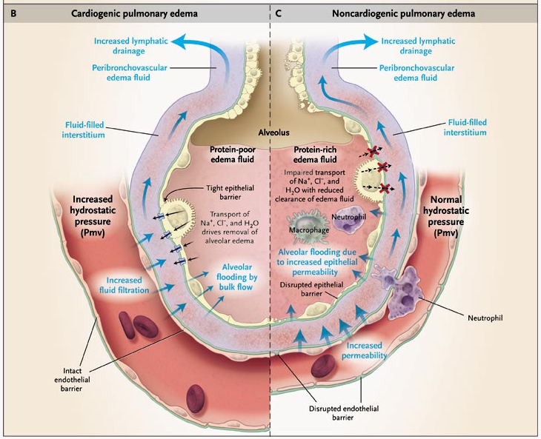
Neurogenic pulmonary edema

Slide 40
Preoperative evaluation
Communication with the neurosurgeon
Time to surgery
Position
Special monitoring
Technique

Slide 42
Preoperative evaluation
Time to surgery
Rebleeding
Peak at 24 hr after SAH
Vasospasm
Peak at day 7 after SAH -> avoid Sx
Major cause of morbidity and mortality after SAH

Slide 43
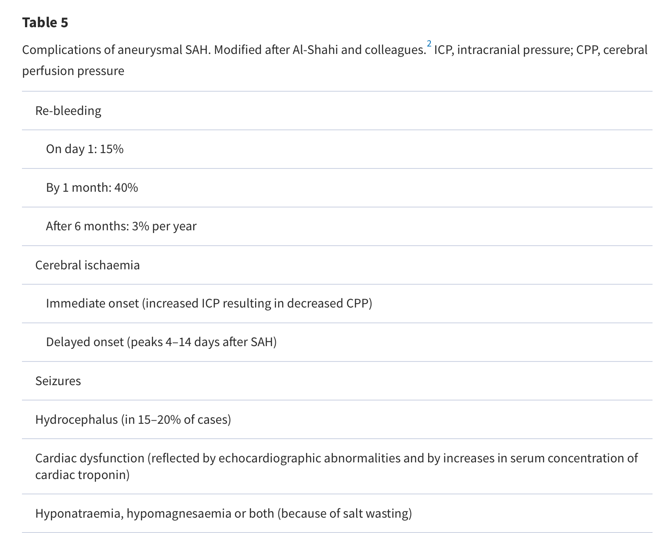

Slide 44
Preoperative evaluation
Vasospasm
Brain ischemia/infarction
Delayed cerebral ischemia
13.5% of the overall mortality and major morbidity
Gold standard Diagnosis -> DSA

Slide 45
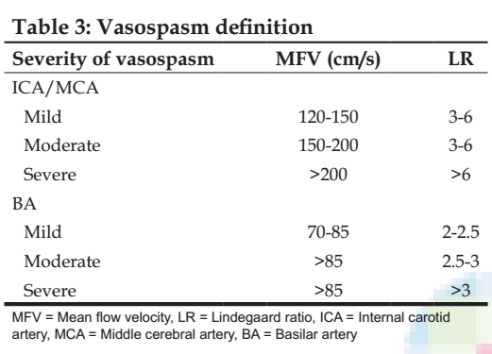
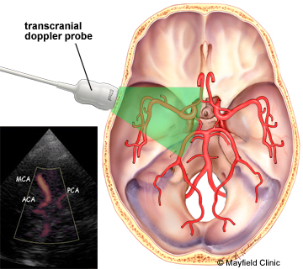
Preoperative evaluation
Vasospasm
Transcranial Doppler(TCD)
Marda MK, Prabhakar H. Transcranial Doppler. J Neuroanaesthesiol Crit Care 2015;2:215-20.

Slide 46
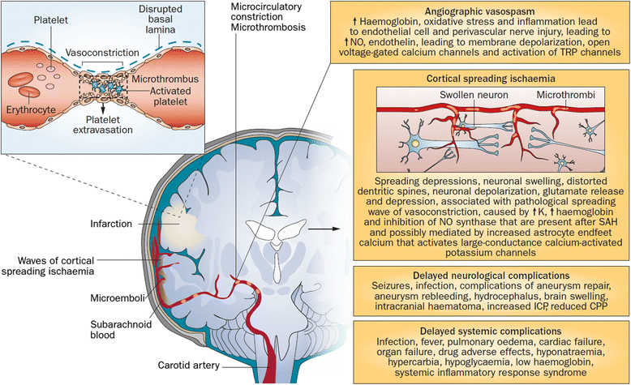
Preoperative evaluation
Vasospasm
Notes:
Blood in SAS→ inflammation→ entrapped macrophages and neutrophils→ endothelins & free radicals→ vasospasm→ stoke

Slide 47
Vasospasm
Management
Triple H therapy
Hypervolemia
CVP 10 mmHg
Hypertensive
SBP 160-200 mmHg after clipping
Hemodilution
Hct 25-30 %
Calcium Channel Antagonists
Oral Nimodipine 60 mg q 4 hr + continue to 21 day
Guidelines for the management of aneurysmal subarachnoid hemorrhage: a guideline for healthcare professionals from the American Heart Association/American Stroke Association. Stroke. 2012;43:
Cottrell and Patel's Neuroanesthesia, 6th Edition
Notes:
SBP 120-150 before clip
160-200 after clip
Another aneurysm SBP 150

Slide 48
Preoperative evaluation
Optimization of the patient’s condition
U/D
HT
Continue Antihypertensive drug
Hemorrhagic stroke
Control BP MAP 110 mmHg

Slide 49
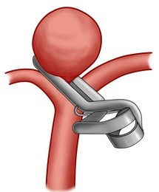
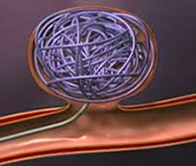
Clipping VS Coiling for Unruptured aneurysm
Site
Size
Age
Clipping
Coiling
Mortality rate 12.2%
Mortality rate 9.5%
International Study of Unruptured Intracranial Aneurysms Investigators. Unruptured intracranial aneurysms: natural history, clinical outcome, and risks of surgical and endovascular treatment. Lancet. 2003 Jul 12;362(9378):103-10. PubMed PMID: 12867109.
Notes:
Site -> MCA aneurysm prefer clipping
Older pt prefer coiling less invasive/ long term consideration น้อยกว่า
Poor clinical grade prefer coiling
Posterior circulation -> coiling

Slide 51
R2 Preparation and Premedication

Slide 52
Preparation
Inform consent
NPO
Force air warmer
Warm IV fluid
Large bore IV
Blood component : PRC 4,FFP 4,Plt 10
DVT prophylaxis
Antihypertensive drugs : IV beta blocker ; Esmolol
Vasopressor : Norepinephrine
Mannitol
Notes:
SAH -> prothrombotic condition -> DVT
sequential compression devices (SCDs), unfractionated heparin, and low molecular weight heparin

Slide 53
Preparation
Monitoring
Standard monitoring : NIBP,O₂sat,ETCO₂ EKG 5 leads, Temperature
Invasive monitoring : A line before induction , C-line ?
Special monitoring : EEG,SSEP
Other : urine output
Notes:
EEG -> guide flow interruption / CMR reducing anesthetic agent
Reveal major ischemic event
SSEP ใช้ได้ทั้ง anterior posterior circulation
Vertebro basillar aneurysm -> EEG ใช้น้อย, ใช้ BAEP,SSEP

Slide 54
Premedication
Antihypertensive drug
Amlodipine(10) 1 tab
Seizure prophylaxis
Antipyretic
Sedative -> decrease anxiety
Barbiturate
Narcotics
Respiratory depression -> increasd ICP
Oral Nimodipine

Slide 55
R3 Anesthetic consideration

Slide 56
Choice of anesthesia
GA with ETT with control ventilation

Slide 57
Position
Depend on location and size of aneurysm
Anterior circulation -> Supine
Basilar tip -> Lateral
Vertebral and basilar trunk -> Park bench
Ensure neck position -> avoid jugular venous obstruction

Slide 58
Intraoperative Management
Smooth induction
Adequate IV access
Control transmural pressure gradient
Maintain CPP
Cerebral protection
Adequate brain relaxation
Balance fluid and electrolytes
Temporary clipping/Permanent clipping
Avoid aneurysm rupture
Allow rapid awakening

Slide 59
Intraoperative Management
Induction
A-line before induction
Reduced BP to 20-25% below baseline
H&H 0
Avoid hyperventilation
TMP = MAP – ICP
TMP gradient สูงขึ้น ถ้า ICP ต่ำลง -> aneurysm rupture
Cottrell and Patel's Neuroanesthesia, 6th Edition
Notes:
HH ต่ำ ไม่เคย brain ischemia -> ทน BP drop ได้ แต่ TMP gradient จะเปลี่ยน เยอะ ถ้า ลด ICP เพราะ ICP ปกติ avoid hyperventilation -> เดี๋ยวแตก
HH สูง ที HX brain ischemia -> avoid BP drop เดี๋ยว brain ischemia เพิ่ม แต่ ลด ICP ได้ เพราะ เดิม ICP สูง ลด icp นิดหน่อย TMP ไม่ค่อยเปลี่ยน

Slide 60
Intraoperative Management
Intubation
Prophylaxis against rise in BP during laryngoscopy
Blunt hemodynamics
High dose narcotic ; Fentanyl 5-10 mcg/kg
Beta blocker ; Esmolol 0.5 mg/kg
Lidocaine 1.5-2 mg/Kg
Second dose propofol 0.5 – 1 mg/kg
Deep level of inhalation
Cottrell and Patel's Neuroanesthesia, 6th Edition

Slide 61
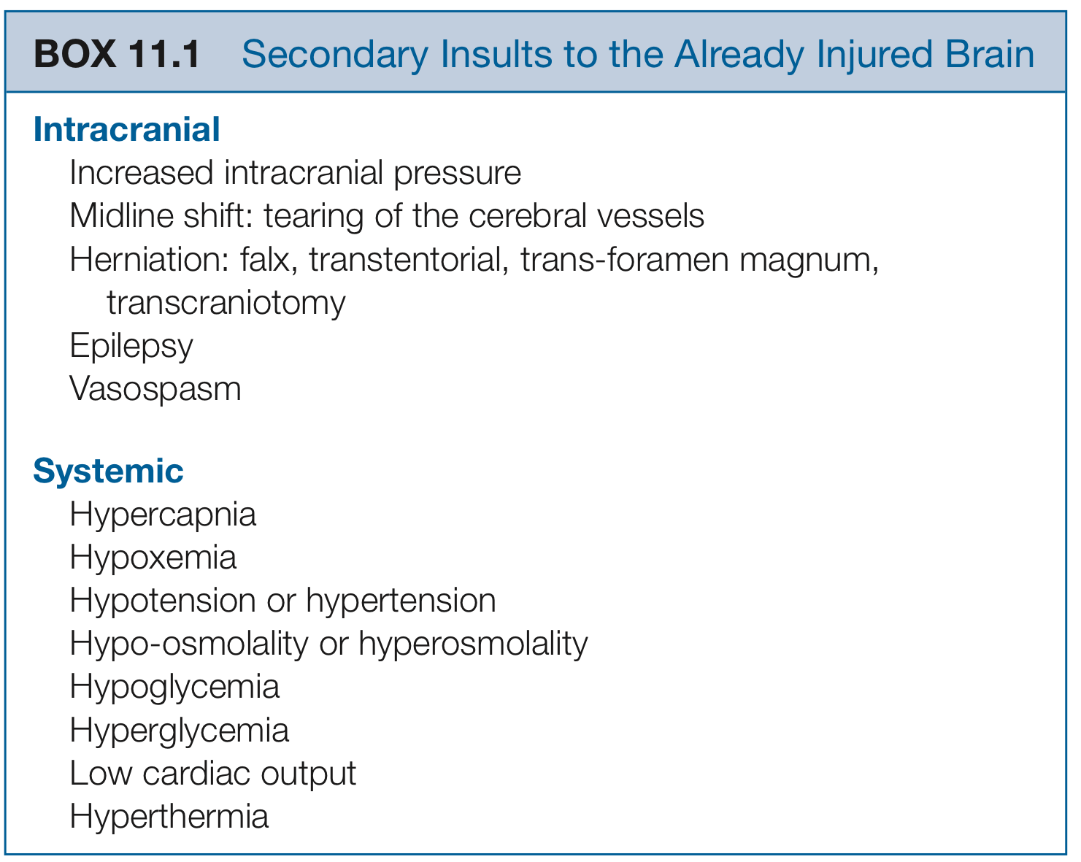
Intraoperative Management
Cerebral protection
Cottrell and Patel's Neuroanesthesia, 6th Edition

Slide 62
Intraoperative Management
Blood sugar control
Avoid Hypo/Hyperglycemia
Focal and global transient cerebral ischemia
BS > 129 mg% -> long term cognitive dysfunction
BS > 152 mg% -> deficit in neurological function
Avoid Anemia
Target Hb 8 - 10 g/dl
Guidelines for the management of aneurysmal subarachnoid hemorrhage: a guideline for healthcare professionals from the American Heart Association/American Stroke Association. Stroke. 2012;43:

Slide 63
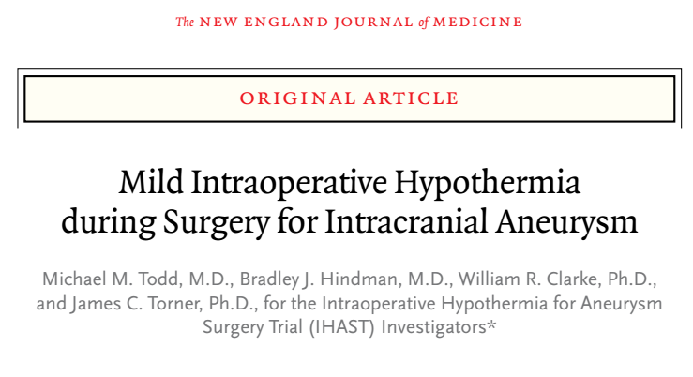
Intraoperative Management
Intraoperative Hypothermia (33.5 C)
Not improve the neurologic outcome after craniotomy among good-grade patients with aneurysmal subarachnoid hemorrhage
Notes:
Mild hypothermia can exert significance cerebroprotecitve effect

Slide 64
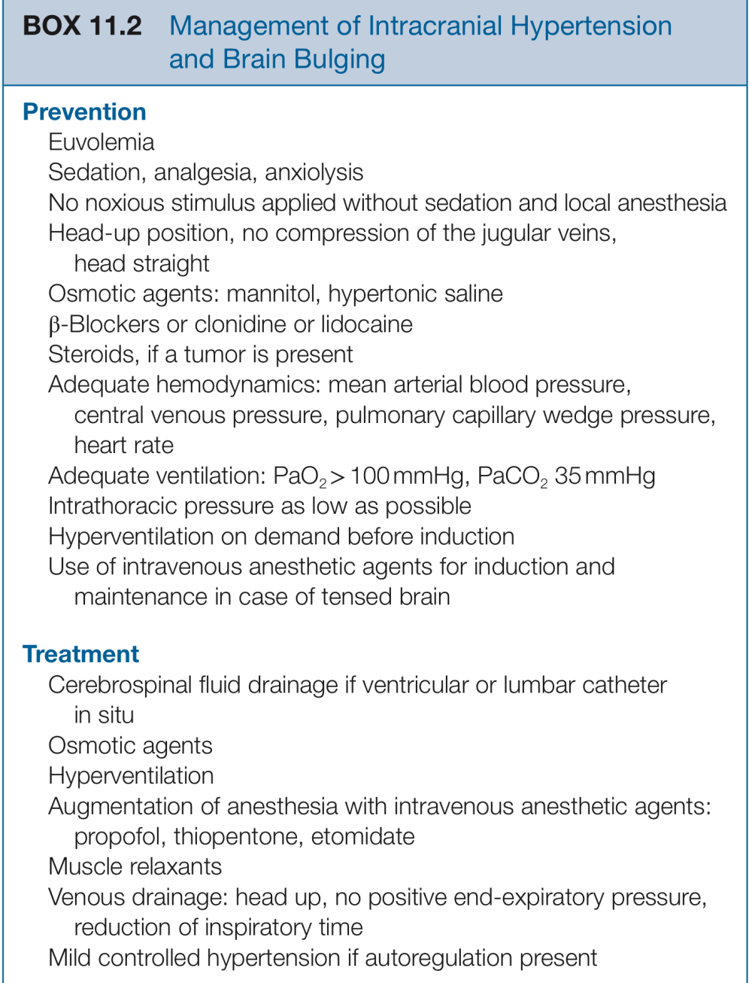
Intraoperative Management
Brain relaxation
20% Mannitol 0.5 - 2 gm/Kg IV over 30 min

Slide 65
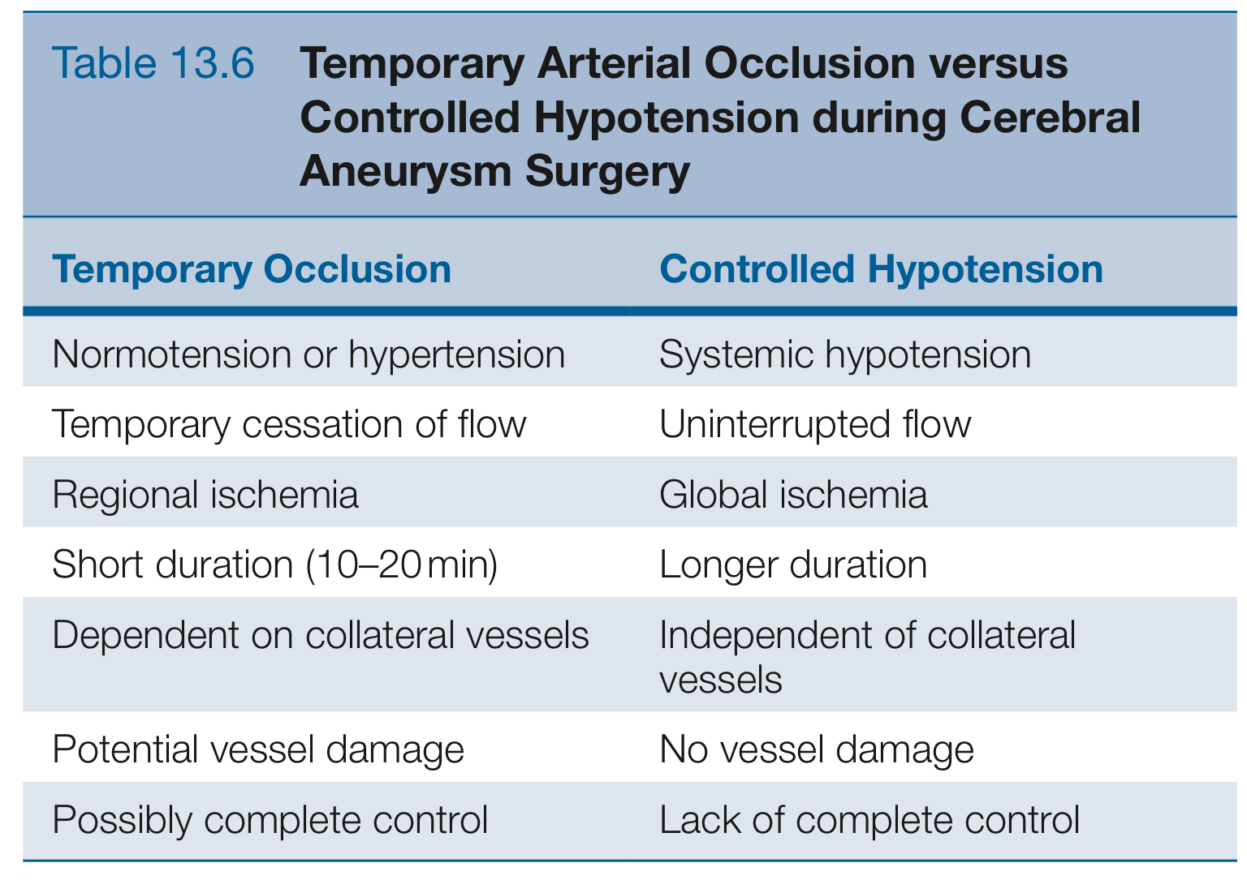
Intraoperative Management
Clipping
Reduce risk of rupture
Controlled hypotension
Temporary occlusion
Notes:
MAP should be sustained to high normal level during occlusion period to facilitate collateral CBF

Slide 66
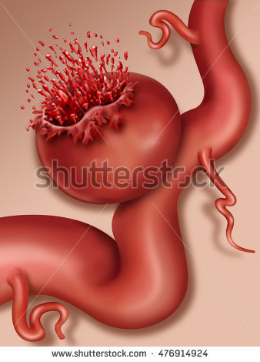
Intraoperative Management
Intraoperative aneurysm rupture
7 % before dissection
48 % during dissection
45 % during clipping
31 % death or disability

Slide 67
Intraoperative Management
Intraoperative aneurysm rupture management
Communication & close monitor V/S
Control bleeding by surgeon -> Temporary clip
Decreased MAP to 50 mmHg or lower
Aggressive fluid resuscitation
Blood transfusion

Slide 68
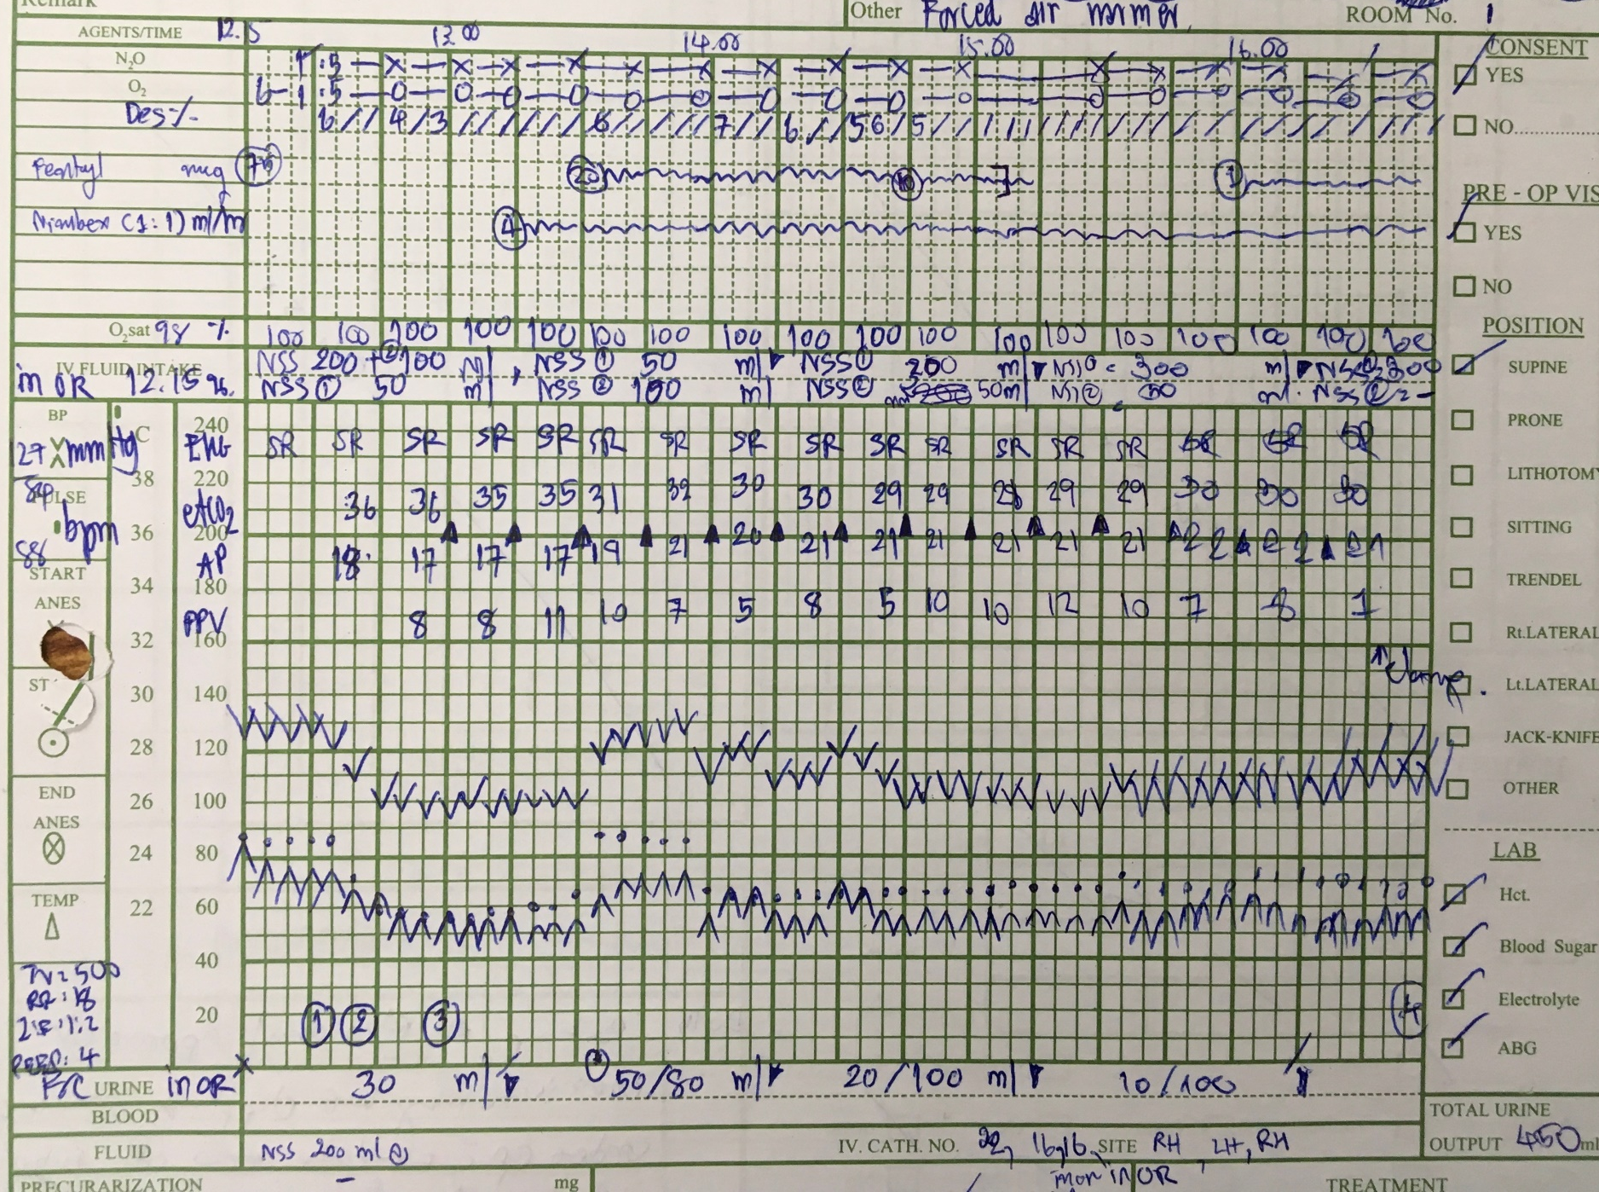
In OR 12.15
Monitor V/S
BP 129/84 mmHg PR 88/min
A line At Lt.RA under LA

Slide 69
Preoxygenation
Fentanyl 75 mcg
Induction : Propofol 100 + 100 mg
Intubation : Cisatracurium 14 mg
On ETT no.7.5 mark 22 cm
Inhalation : N₂0 : 0₂ = 0.5 :0.5 Desflurane up to 6 %
Access IV no .16 x 2
Monitor temperature
LA before pinning

Slide 70
ABG baseline
pH 7.39 pO₂ 270 HCO 26 pCO₂ 44 ETCO₂ 35
HCT 36 % DTX 104 mg%
VCV mode TV 500 I:E 1:2 RR 12 -> 16

Slide 71
Start operation 13.35
Fentanyl 20 mcg/hr
Cisatracurium 4mg/hr

Slide 72
Temporary clipping At 1638 -1650
Occlusion time 12 minutes

Slide 73
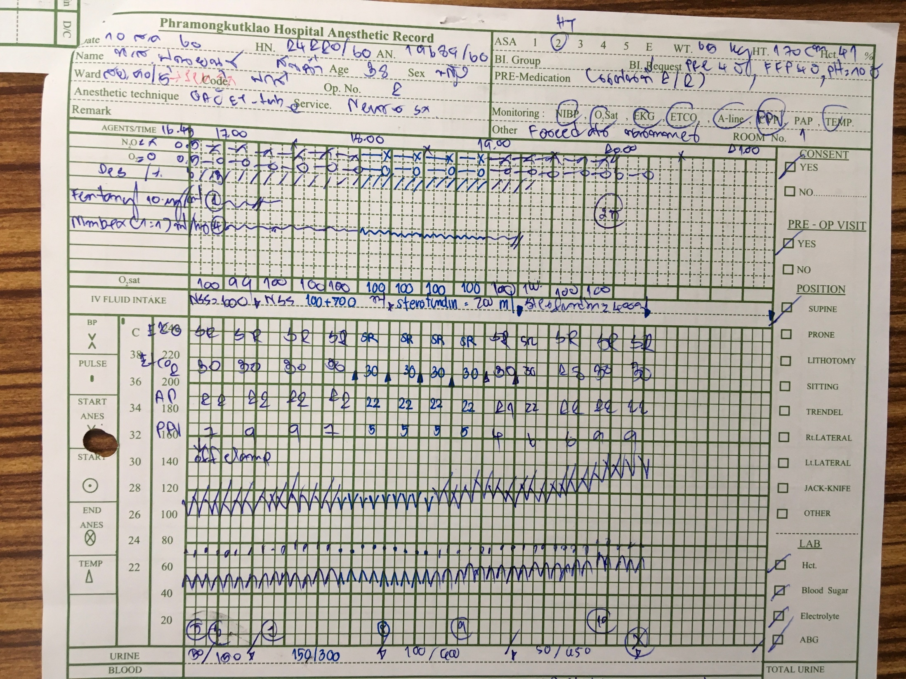
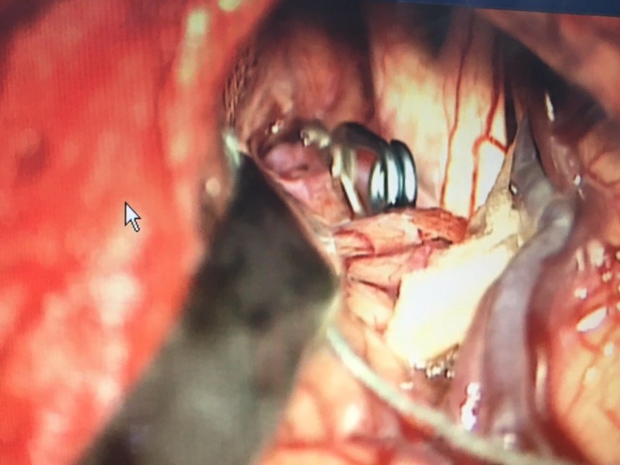
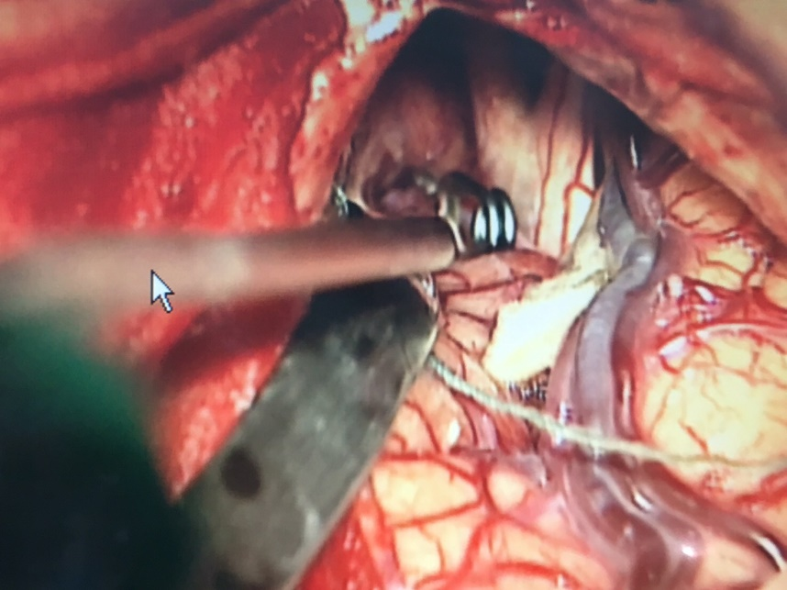
Temporary clipping At 16.38 -16.50
Occlusion time 12 minutes

Slide 74
Indocyanine green IV

Slide 75
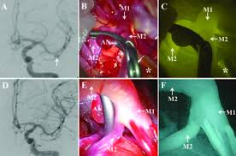
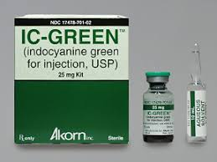
Indocyanine green
Intraoperative contrast angiography
25 mg IV ICG
Can interfere O₂sat , Anaphylaxis

Slide 76
Emergence
H&H I-II -> extubate
H&H III -> may extubate
H&H IV-V -> required postoperative ventilatory support
Intraoperative aneurysm rupture -> recover slowly -> required postoperative ventilatory support
Notes:
After extubation, supplemental oxygen

Slide 77
Emergence
Prostigmine 2.5 mg + Atropine 1.2 mg

Slide 78
Post operative management
Assess neurological status in ICU
Prevent cerebral vasospasm and delayed cerebral ischemia
Management complication
Hydrocephalus
Seizure
Fever
Screening of family members
Notes:
Avoid Post-operative hypoventilation and atelectesis

Slide 79
Post Operative Day 1
S : ตื่นดี หายใจปกติ ไม่มีปวดแผล ไม่มี N/V
O : BP 132/70 mmHg PR 93 BPM
BT 37.4°C RR 18 breaths /min
E₄M₆V_{5,}
No neurodeficit
A + P
S/P clipping aneurysm day 1
NPO
Pain control : Fentanyl 50 mcg v prn q 4 hr
Anticonvulsive drug : Dilantin 750 mg v load then 100 mg v q 8 hr

Slide 80
Post Operative Day 2
S : ตื่นดี หายใจปกติ ไม่มีปวดแผล ไม่มี N/V
O : BP 121/74 mmHg PR 90 BPM
BT 37.6°C RR 20 breaths /min
E₄M₆V_{5,}
No neurodeficit
A + P
S/P clipping aneurysm day2
Soft diet
Pain control : Para 500 1 tab prn q 6 hr
Anticonvulsive drug : Dilantin 100 mg v q 8 hr
Continue Anti HT drug : Losartan,Amlodipine

